Slide 1
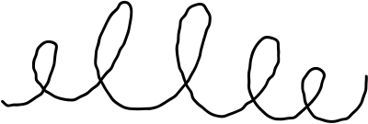


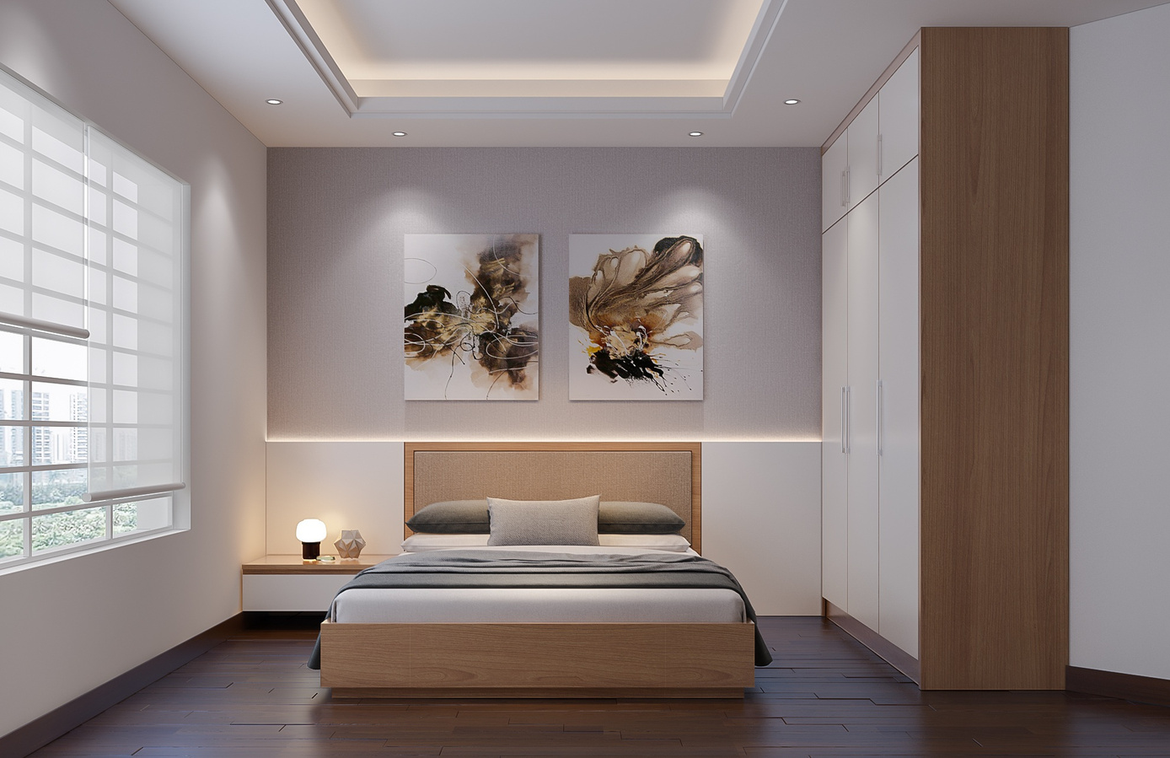



ModifAI
Project Update 1
A concise overview of our interior decor app's progress and challenges

Slide 2





Group Introduction: Meet Our Team Members
Akram Hossain Apu Khan – 2231090642
Mehedi Hasan Dip – 2232167042
Hacibull Hashan Tosher – 2111626642
Together, we create innovative solutions for interior decor!

Slide 3
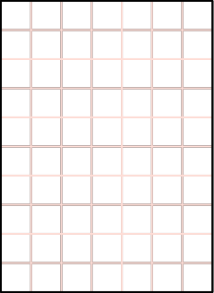

ModifAI Project Update Overview
An overview of the current status, completed tasks, and future plans for our AI-powered interior decor app project.
Team Introduction
Project Overview
Progress Update
Our group consists of Akram Hossain Apu Khan – 2231090642, Mehedi Hasan Dip – 2232167042, and Hacibull Hashan Tosher – 2111626642.
ModifAI aims to revolutionize the interior decor experience by leveraging artificial intelligence for personalized design solutions tailored to user preferences.
We have successfully completed key pages including welcome, login, signup, home, and profile sections that enhance user interaction and accessibility.

Slide 4
Overview of Completed Pages in ModifAI App
The welcome page greets users with a friendly interface and easy navigation.
The login page allows users to securely access their accounts with minimal steps.
The signup page features a simple form for new users to register effortlessly.
The home page showcases personalized decor suggestions tailored to user preferences.

Slide 5
Current Issues in ModifAI's Development Process
UI rendering discrepancies affecting user experience and functionality.
Challenges in establishing a reliable AI-mobile connection for seamless interaction.
Latency issues impacting real-time updates and responsiveness in the app.
Integration hurdles between the AI model and the mobile interface's design.

Slide 6
Upcoming Tasks: Enhancing AI Integration and User Experience
Fixing UI rendering issues to improve the overall user experience.
Integrating the AI model with the API key for smoother functionality.
Establishing a reliable AI-mobile connection for seamless interaction.
Conducting thorough testing to ensure stability and performance of all features.

Slide 7



Conclusion and Future Work
In conclusion, the ModifAI project has made significant progress but still faces challenges. Moving forward, our primary focus will be on integrating the AI model with the API key, ensuring smooth communication between the app and the AI. Additionally, we will address UI rendering issues and enhance the mobile connection. By tackling these tasks, we aim to provide a seamless user experience that aligns with our vision for an AI-powered interior decor app. Together, we will ensure the successful launch of ModifAI!

